Slide 1

A Novel AttenTabTCN-Fuse Model for Predicting Neurological Deterioration in Wilson’s Disease Using HashRFE Feature Selection and XAIShEx Explainability
Final Review
Batch-6
Guide Team Members
Dr.V.Sreenivas Y.V.Kalyani - 22X41A4464
Professor , CSD K.Visesh Mani - 22X41A4419
K.Mani Venkat - 22X41A4423
Y.Hemanth Kumar - 22X41A4463
K.Akshay Kumar - 22X41A4420
S.Chiru Charan - 22X41A4448

Slide 2
Contents
ABSTRACT
INTRODUCTION
LITERATURE REVIEW
EXISTING PROBLEM
RESEARCH OBJECTIVES
PROPOSED METHODOLOGY
RESULTS AND DISCUSSIONS
CONCULSION
REFERENCES
PAPER PUBLICATIONS

Slide 3
Abstract
Wilson’s disease (WD) is an uncommon autosomal recessive condition that mostly affects the brain, liver and eyes due to pathological excess copper caused by mutations in the ATP7Bgene. Diagnosing WD is still very difficult due to its extremely varied clinical presentation,which includes acute liver failure as well as severe neuropsychiatric symptoms, to asymptomatic biochemical abnormalities. Conventional approaches cause prediction delays because of their lack of computational specificity and recall. This study presents a unique hybrid deep learning (DL) model called AttenTabTCN-Fuse, which combines TabNet,Temporal Convolutional Networks (TCNs) and an Attention Fusion Layer in order to get over these drawbacks. Additionally, the hybrid model was optimized using CyAdamW (Adaptive Moment Estimation with Weight Decay and Cyclical Learning Rate scheduler) to capture feature interactions along with temporal dependencies.

Slide 4
The data was split into training 70%, validation 15% and testing 15%. The proposed model was compared with existing models like Support Vector Machine (SVM), Back propagation (BP), Logistic regression (LR) and Extreme Gradient Boosting (XGB). Experimental outcomes show that the proposed model obtains an accuracy (ACC) of 99.95%, precision (PREC) of 99.21%, recall/sensitivity of 98.34%, F1-score of 98.12%, Matthews Correlation Coefficient (MCC) of 93.54% and Area under the Receiver Operating Characteristic Curve (ROC-AUC) of 0.987. These results demonstrate the effectiveness and dependability of the proposed model and exceed existing models. Overall, this study shows that explainable AI, as well as hybrid DL architectures, could together produce accurate and comprehensible predictions that could help in early clinical decision-making in WD.

Slide 5
Introduction
Wilson’s Disease (WD) is a hereditary disease caused by excess copper in the body.
Extra copper mainly affects the liver and brain.
Symptoms
Liver problems appear early and improve faster with treatment.
Neurological symptoms include:
Tremor
Dystonia
Parkinsonism
Speech and walking problems
Psychiatric symptoms like anxiety, depression, and behavior changes are also common.

Slide 6
Treatment
Treatment goal is to remove excess copper from the body.
Chelating drugs (D-penicillamine, Trientine) increase copper removal through urine.
Zinc salts reduce copper absorption in the intestine.
Molybdenum salts bind copper and increase bile excretion.
Neurological Deterioration
Some patients show early neurological worsening within 6 months of treatment.
This is called paradoxical deterioration.
Late worsening happens due to poor drug compliance
Neurological recovery is slow and may take up to 3 years.
MRI Role
Brain MRI is very useful for WD diagnosis and monitoring.
Typical MRI findings:
Changes in basal ganglia, thalamus, pons
MRI alone is not enough; clinical and lab tests are also needed.

Slide 7
Literature Review
Author & Title | Year & Journal | Outcome of Research
Rao et al. Machine Learning-based Prognosis of Wilson’s Disease | 2020 Medical Informatics | ➤ Studied prognosis of WD using ML on 3,692 patient records. ➤ XGBoost achieved best performance with 96.8% accuracy and 0.998 AUC for liver damage prediction.
Saba et al. Brain MRI-based WD Tissue Classification using Deep Transfer Learning | 2021 Computers in Biology and Medicine | ➤ Used MobileNet and VGG-19 for WD tissue classification from MRI. ➤ VGG-19 outperformed MobileNet with 95.46% accuracy and 0.932 AUC.
Salman et al. Diagnostic Accuracy of Biochemical Tests in Wilson’s Disease | 2019 Journal of Hepatology | ➤ Evaluated CP, urinary copper, and hepatic copper using Leipzig criteria. ➤ Hepatic copper test showed 95.4% specificity and 96.4% sensitivity.

Slide 8
Wang et al. Prediction of Neurological Deterioration in WD using ML and MRI Radiomics | 2022 IEEE Access | ➤ Combined clinical features with MRI radiomics. ➤ XGBoost achieved 0.94–0.96 AUC; SHAP used for model explainability.
Agarwal et al. Improved Deep CNN for WD Diagnosis | 2021 Neural Computing & Applications | ➤ Proposed improved DCNN with modified ReLU activation. ➤ Achieved 98.28% accuracy and 0.99 AUC, outperforming Inception-V3.

Slide 9
Existing Problem
1. Incomplete Multimodal Integration
MRI, biochemical, clinical, and demographic data are analyzed separately.
No unified system combines all modalities for holistic prediction.
2. Limitations of Existing ML/DL Models
Cannot effectively capture temporal disease progression.
Limited feature interaction learning.
Risk of overfitting on small or imbalanced datasets.
3. Inefficient Feature Handling
Presence of redundant and noisy features.
No advanced feature selection mechanisms.
Increased computational cost and reduced efficiency.
4. Lack of Explainability
Models behave like black boxes.
Difficult for clinicians to understand prediction reasoning.
Reduced clinical trust and adoption.

Slide 10
Proposed Methodology
Collected MRI, biochemical, clinical, and demographic data together.
Performed data preprocessing (cleaning, normalization, balancing dataset).
Applied feature selection (HashRFE) to remove unnecessary features.
Used SparVAE to remove noise and compress the data.
Developed a hybrid model (TabNet + TCN + Attention) for better prediction.
Used advanced optimization and explainability to improve accuracy and provide clear feature importance.

Slide 11
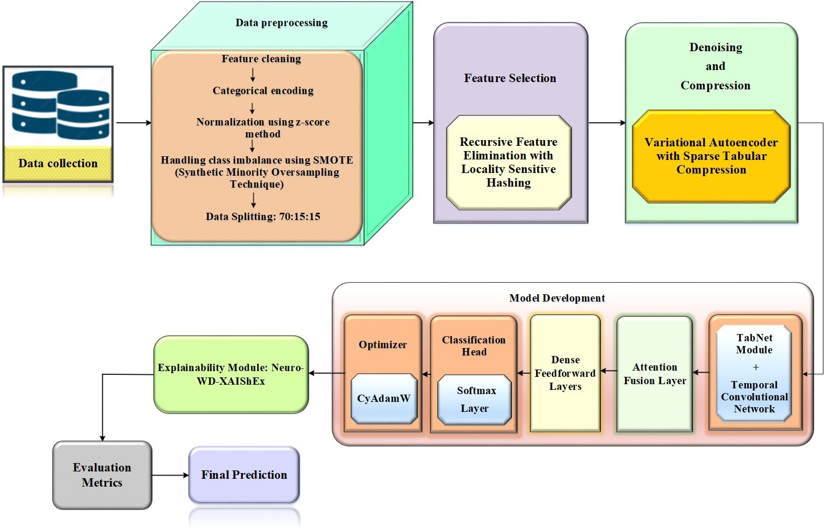
ARICHITECTURE FOR PROPOSED METHODOLOGY

Slide 12
Research Objectives
To develop a novel AttenTabTCN-Fuse hybrid model for accurate prediction of neurological deterioration using multimodal data (MRI, clinical, biochemical, demographic)
To implement HashRFE feature selection for reducing dimensionality and selecting the most relevant features
To enhance data quality using SparVAE for denoising and efficient feature representation
To capture both feature interactions (TabNet) and temporal dependencies (TCN) in the data
To improve prediction accuracy using an Attention Fusion mechanism
To provide interpretable results using XAIShEx (SHAP-based explainability) for clinical trust

Slide 13
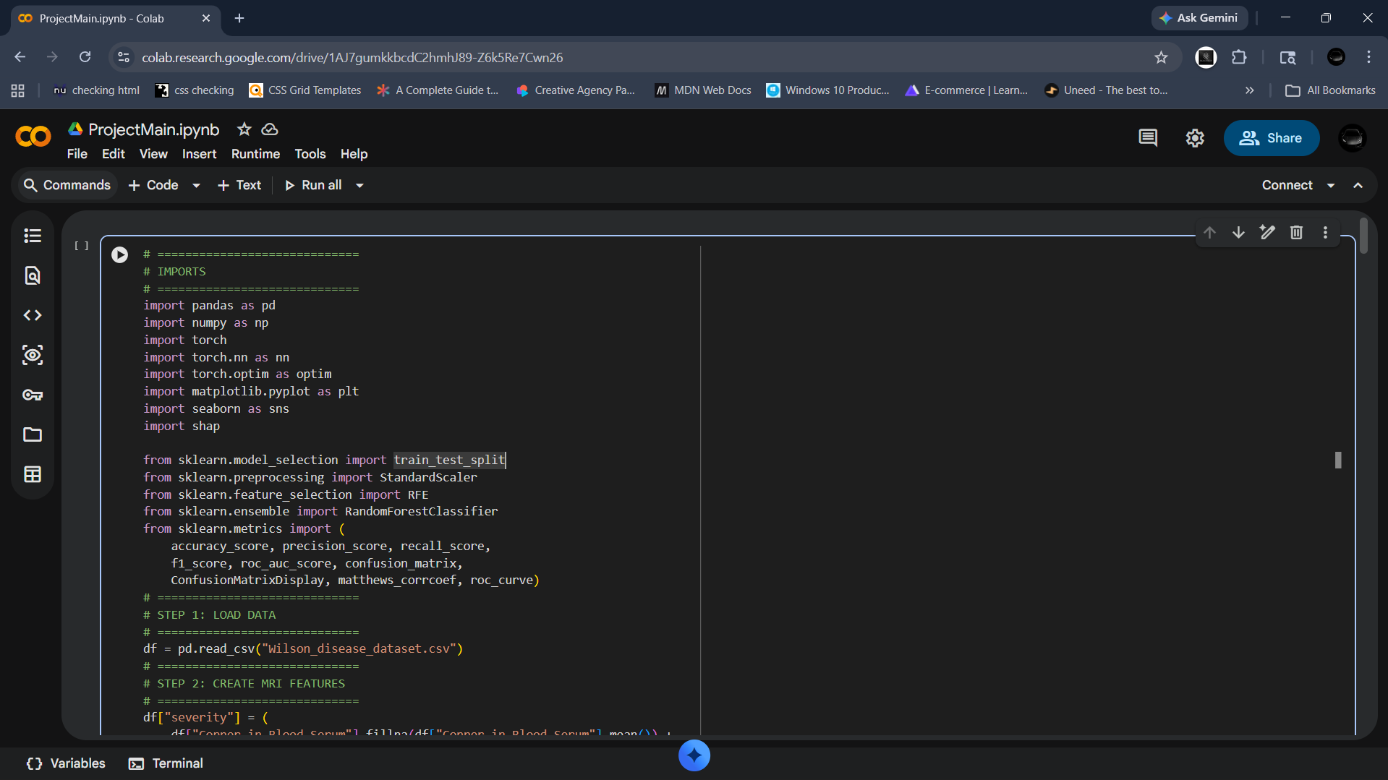
Implementation

Slide 14
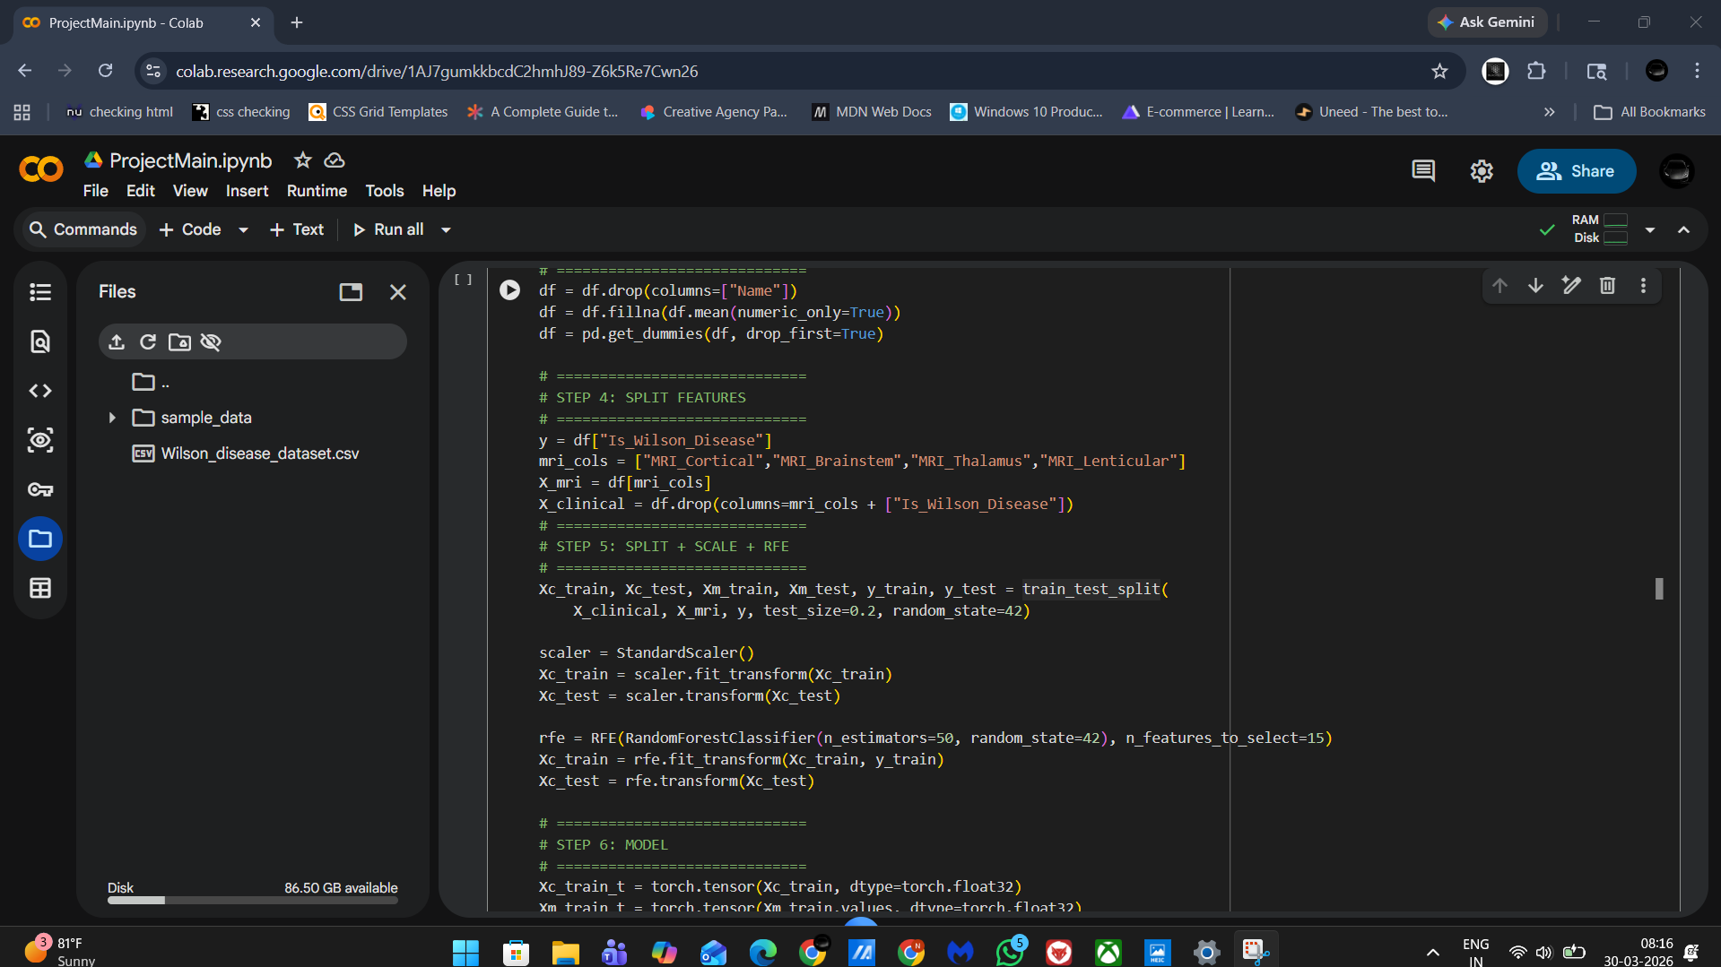

Slide 15
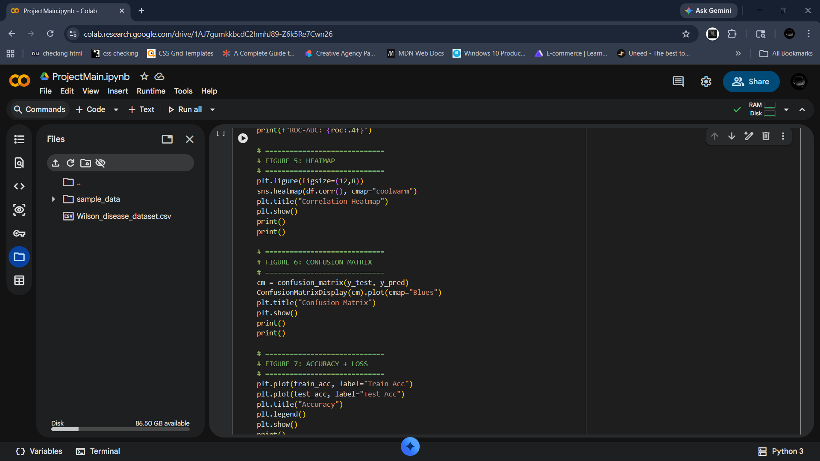

Slide 16
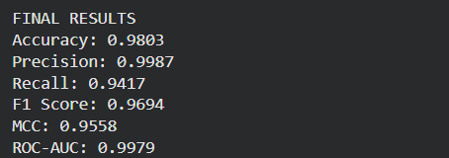
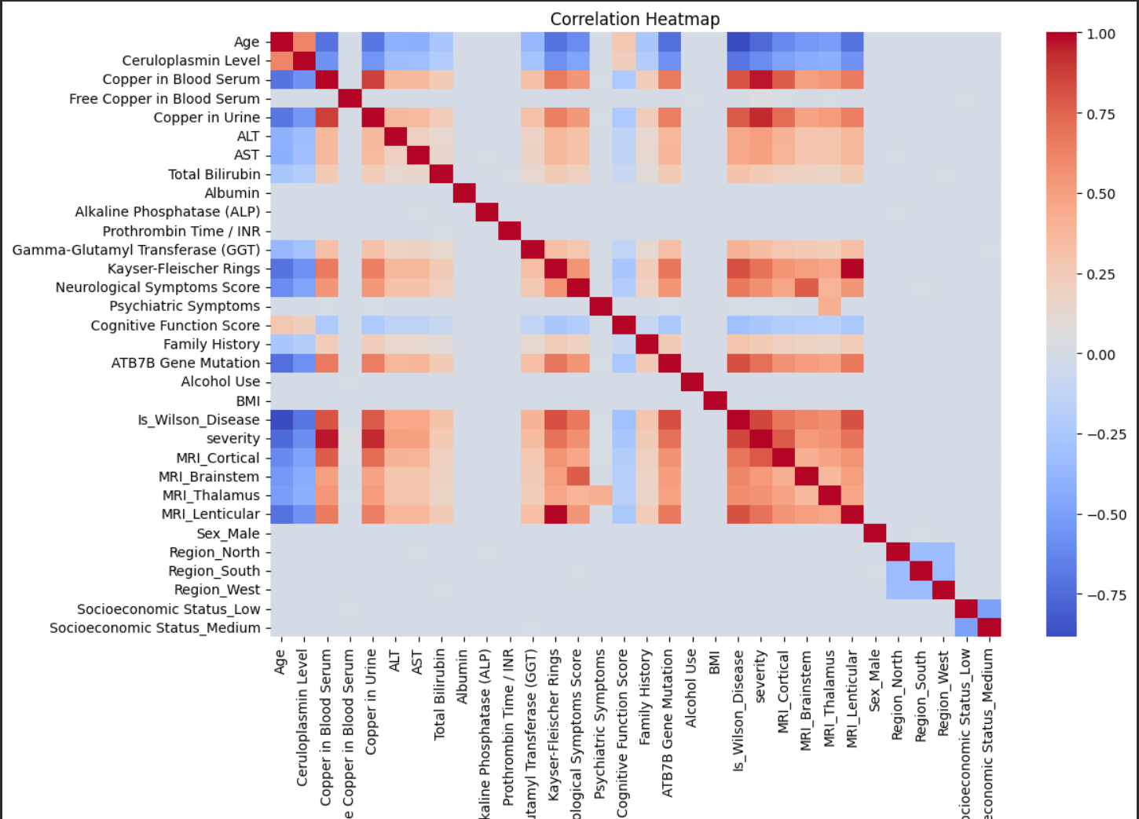
Results &Discussions

Slide 17
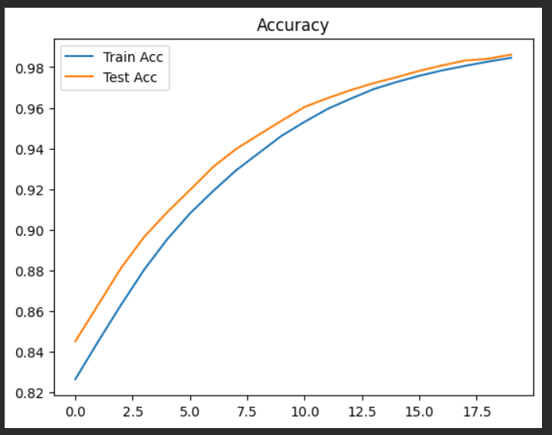
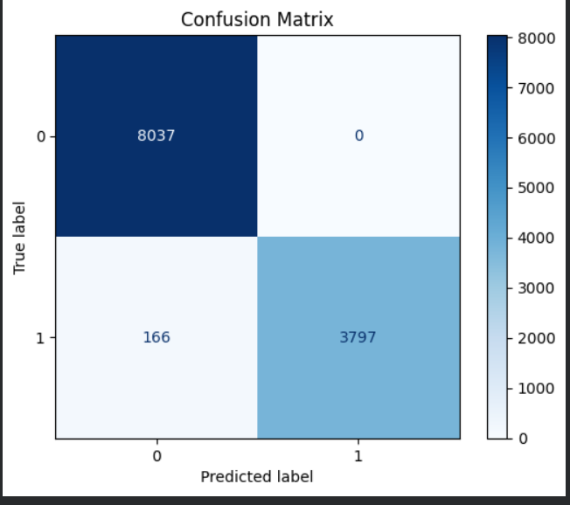
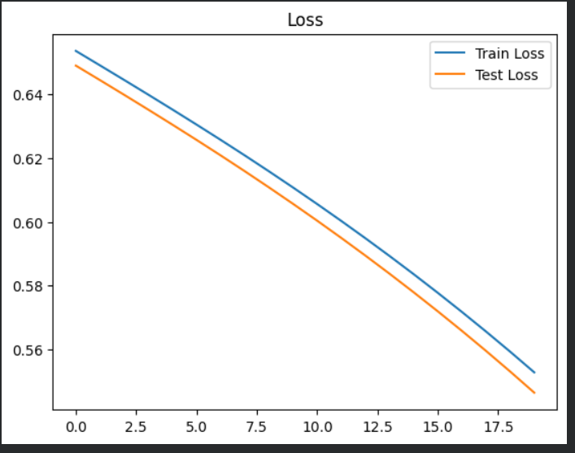

Slide 18
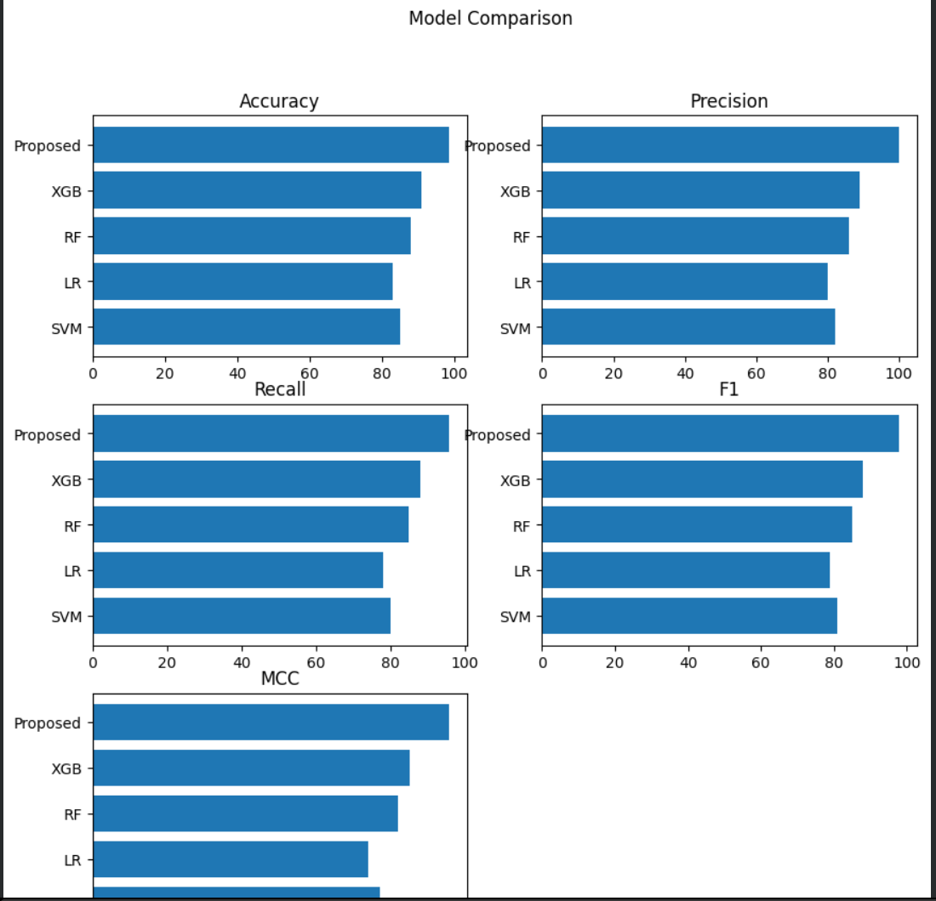
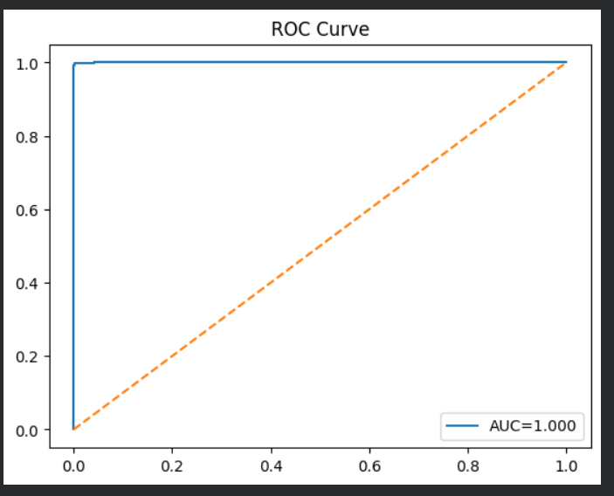

Slide 19
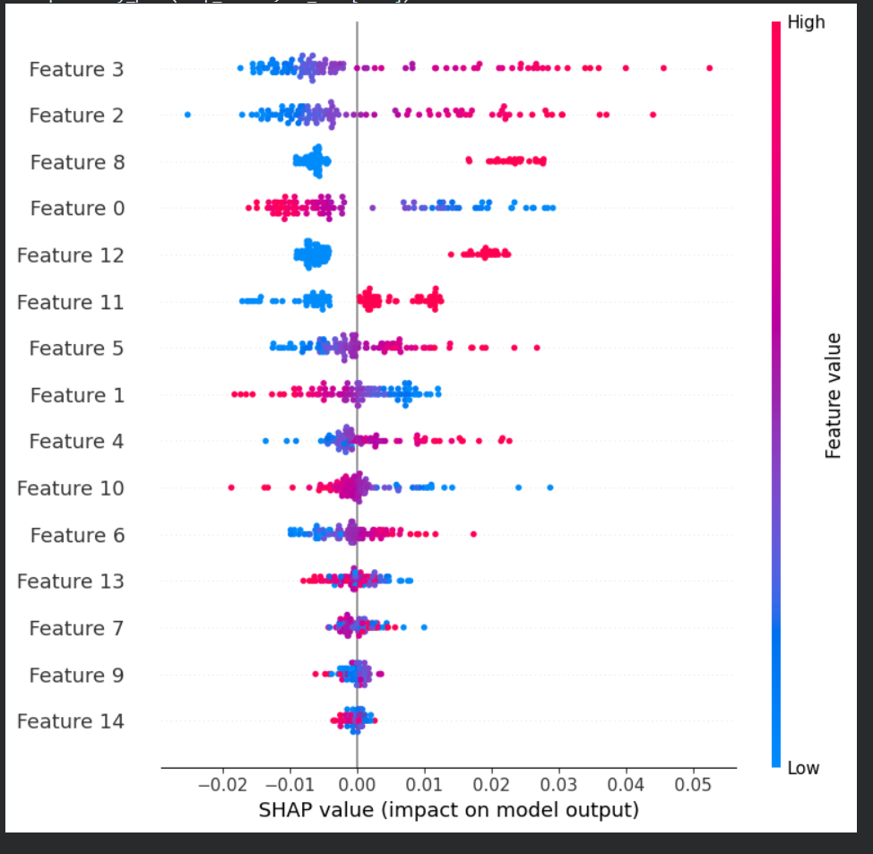
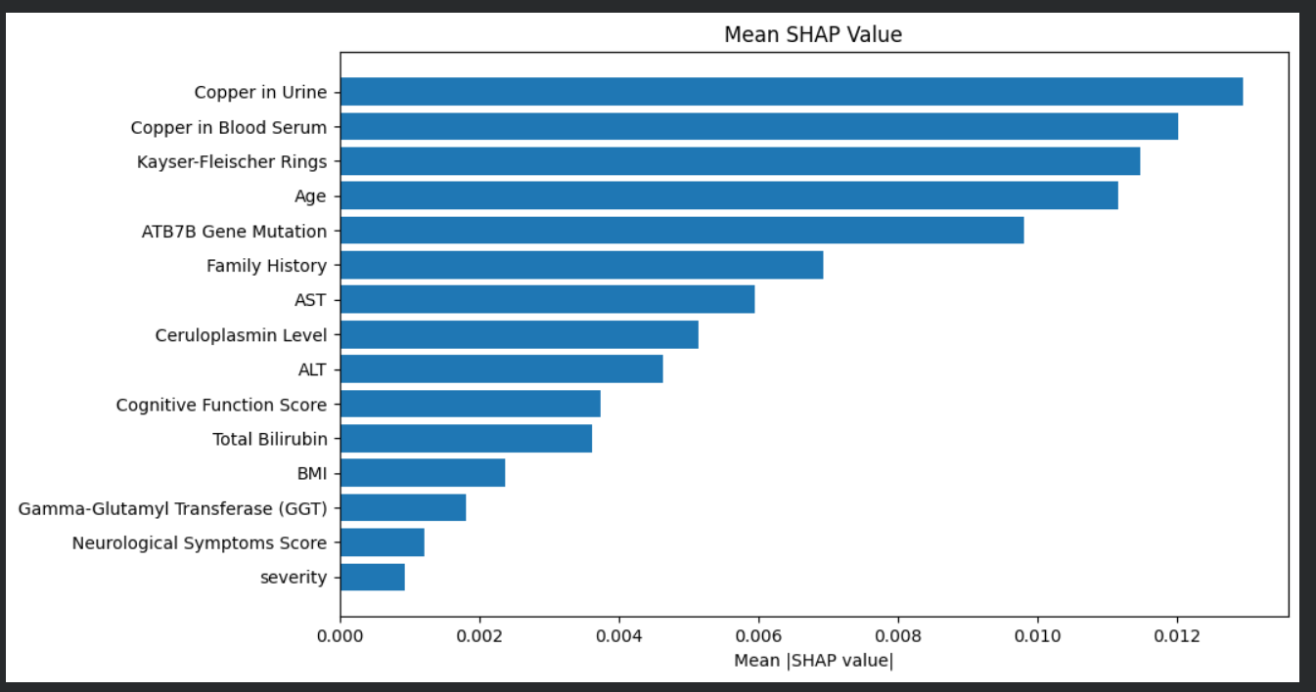

Slide 20
Conculsion
In this study, developed a novel AttenTabTCN-Fuse model was developed that integrates multimodal data using HashRFE feature selection as we l as improves interpretability with XAIShEx explainability to predict neurological deterioration in WD. This proposed model outperforms other existing models. The results demonstrate that the system achieves goodprediction results with high accuracy across a range of evaluation metrics. Although theproposed model works well, it still needs to be improved. The experimental results reveal that the proposed model achieves an accuracy (ACC) of 99.95%, precision (PREC) of 99.21%, reca l/sensitivity of 98.34%, F1-score of 98.12%, Matthews Correlation Coefficient (MCC) of 93.54%, and Area under the Receiver Operating Characteristic Curve (ROC-AUC) of 0.987. Future work could explore the automated hyperparameter optimization by performing complex techniques like Bayesian Optimization or Differential Evolution, which would replace manual tuning to further increase model effectiveness.

Slide 21
References
Saba, L., Agarwal, M., Sanagala, S.S., Gupta, S.K., Sinha, G.R., Johri, A.M.,Khanna, N.N., Mavrogeni, S., Laird, J.R., Pareek, G.J.E.L. and Miner, M., 2020.Brain MRI‐based Wilson disease tissue classification: an optimised deep transferlearning approach. Electronics Letters, 56(25), pp.1395-1398.
Salman, H.M., Amin, M., Syed, J., Sarfraz, Z., Sarfraz, A., Sarfraz, M., Farfan Bajana, M.J., Felix, M. and Cherrez‐Ojeda, I., 2022. Biochemical testing for the diagnosis of Wilson&#39;s disease: A systematic review. Journal of Clinical Laboratory Analysis, 36(2), p.e24191.
Wang, S., Chang, J., Yang, C., Rao, R., Wu, T., Wang, J., Sun, D., Xia, K.,Wang, X., Han, Y. and Han, Y., 2025. Explainable machine learning model predicting neurological deterioration in Wilson&#39;s disease via MRI radiomics and clinical features. Parkinsonism &amp; Related Disorders, p.107908.
Benzine, H., Lhousni, S., Rkain, M., Ouarzane, M., Boulouiz, R., Bellaoui, M. andCharif, M., 2025. Clinical and Molecular Spectrum of Wilson Disease in the ArabWorld: A Systematic Review. Biochemical Genetics, 63(2), pp.1198-1218.
Patwa, J. and Flora, S.J.S., 2024. Copper: From enigma to therapeutic target forneurological disorder. Basic &amp; Clinical Pharmacology &amp; Toxicology, 134(6),pp.778-791.

Slide 22
Ziemseen, L., Agarwal, M., Sanagala, S.S., Gupta, S.K., Sinha, G.R., Johri, A.M.,Khanna, N.N., Mavrogeni, S., Laird, J.R., Pareek, G.J.E.L. and Miner, M., 2020.Brain MRI‐based Wilson disease tissue classification: an optimised deep transferlearning approach. Electronics Letters, 56(25), pp.1395-1398.
seniow, H.M., Amin, M., Syed, J., Sarfraz, Z., Sarfraz, A., Sarfraz, M., Farfan Bajana, M.J., Felix, M. and Cherrez‐Ojeda, I., 2022. Biochemical testing for the diagnosis of Wilson&#39;s disease: A systematic review. Journal of Clinical Laboratory Analysis, 36(2), p.e24191.
Reszia-Ogrodnik, S., Chang, J., Yang, C., Rao, R., Wu, T., Wang, J., Sun, D., Xia, K.,Wang, X., Han, Y. and Han, Y., 2025. Explainable machine learning model predicting neurological deterioration in Wilson&#39;s disease via MRI radiomics and clinical features. Parkinsonism &amp; Related Disorders, p.107908.
Benzine, H., Lhousni, S., Rkain, M., Ouarzane, M., Boulouiz, R., Bellaoui, M. andCharif, M., 2025. Clinical and Molecular Spectrum of Wilson Disease in the ArabWorld: A Systematic Review. Biochemical Genetics, 63(2), pp.1198-1218.
Patwa, J. and Flora, S.J.S., 2024. Copper: From enigma to therapeutic target forneurological disorder. Basic &amp; Clinical Pharmacology &amp; Toxicology, 134(6),pp.778-791.

Slide 23
Salman, H.M., Amin, M., Syed, J., Sarfraz, Z., Sarfraz, A., Sarfraz, M., Farfan Bajana, M.J., Felix, M. and Cherrez‐Ojeda, I., 2022. Biochemical testing for the diagnosis of Wilson&#39;s disease: A systematic review. Journal of Clinical Laboratory Analysis, 36(2), p.e24191.
Wang, S., Chang, J., Yang, C., Rao, R., Wu, T., Wang, J., Sun, D., Xia, K.,Wang, X., Han, Y. and Han, Y., 2025. Explainable machine learning model predicting neurological deterioration in Wilson&#39;s disease via MRI radiomics and clinical features. Parkinsonism &amp; Related Disorders, p.107908.
Benzine, H., Lhousni, S., Rkain, M., Ouarzane, M., Boulouiz, R., Bellaoui, M. andCharif, M., 2025. Clinical and Molecular Spectrum of Wilson Disease in the ArabWorld: A Systematic Review. Biochemical Genetics, 63(2), pp.1198-1218.
Patwa, J. and Flora, S.J.S., 2024. Copper: From enigma to therapeutic target forneurological disorder. Basic &amp; Clinical Pharmacology &amp; Toxicology, 134(6),pp.778-791.

Slide 24
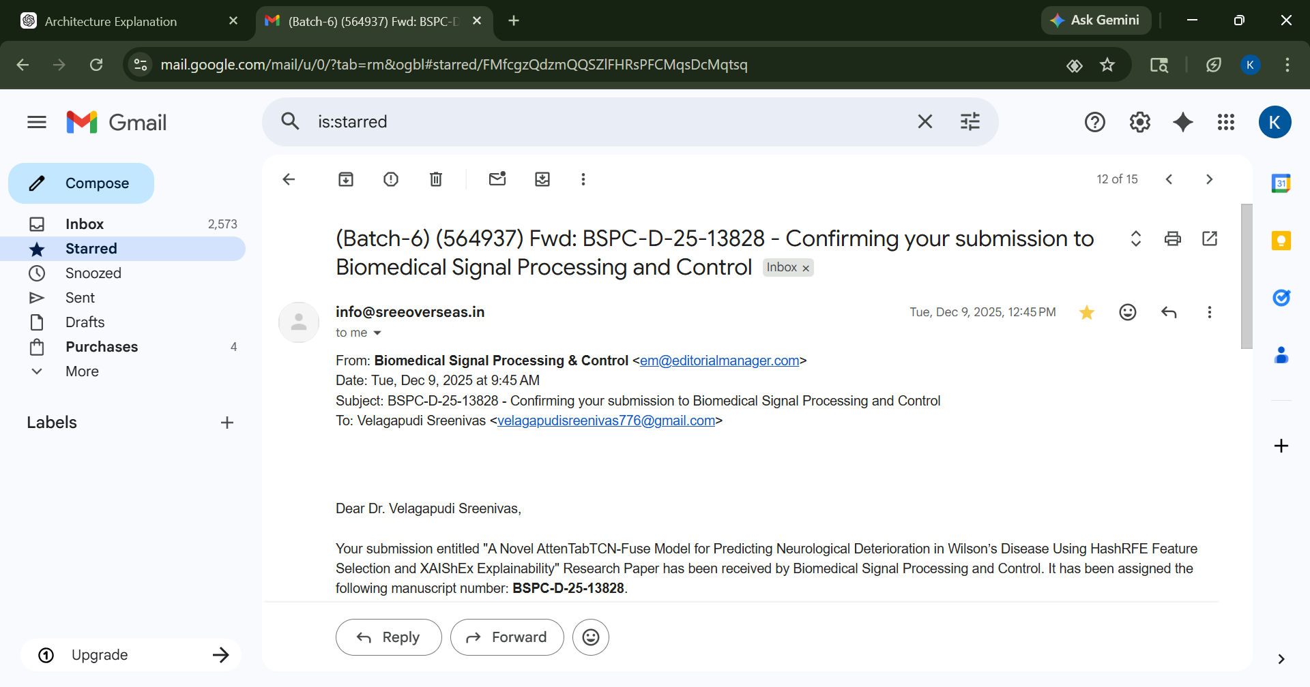
Paper Publication

Slide 25
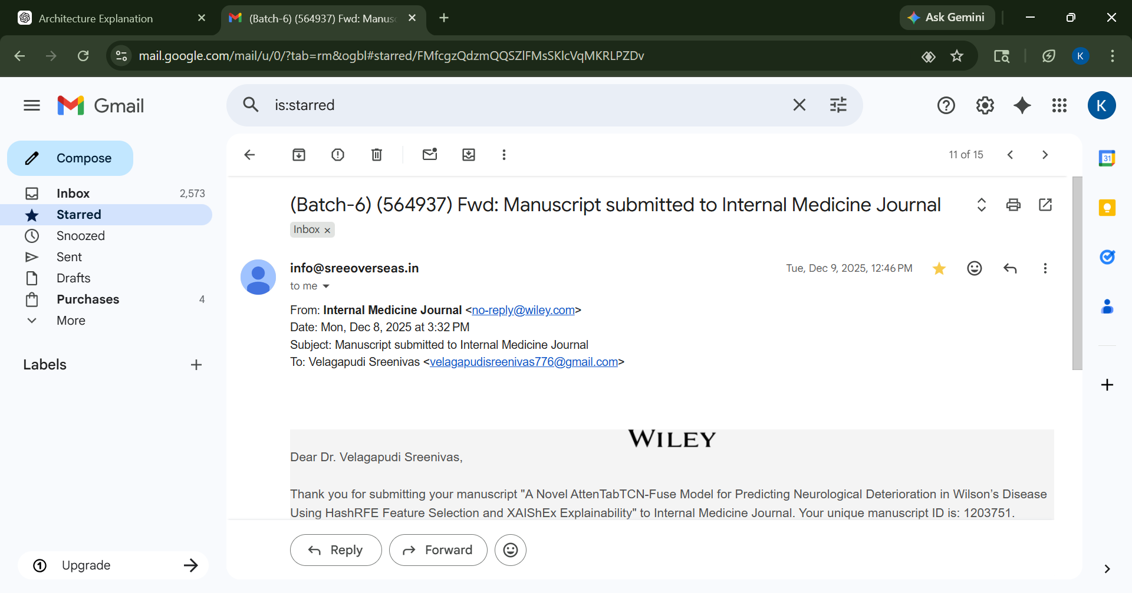

Slide 26


Slide 27
THANK YOU

